Slide 1
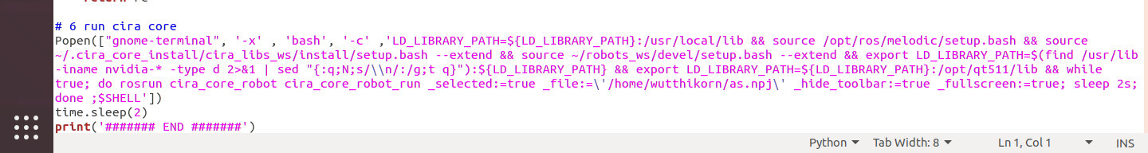
CiRA CORE Autorun (Some fix)
Open cira_robot_autorun (Ubuntu Version)
cira_core
cira_core_run
If you don’t want to autorun with full screen, just delete it.
*For Ubuntu version (file)
Directory of your project file

Slide 2
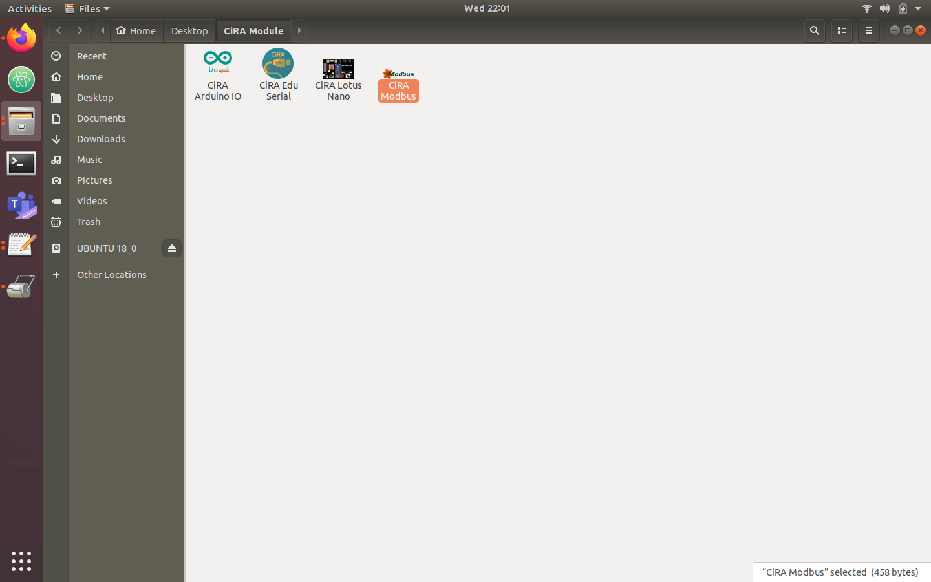
CiRA CORE Autorun (Some fix)
To autorun with ModBus
Right click on CiRA Modbus and Open With Other Application

Slide 3
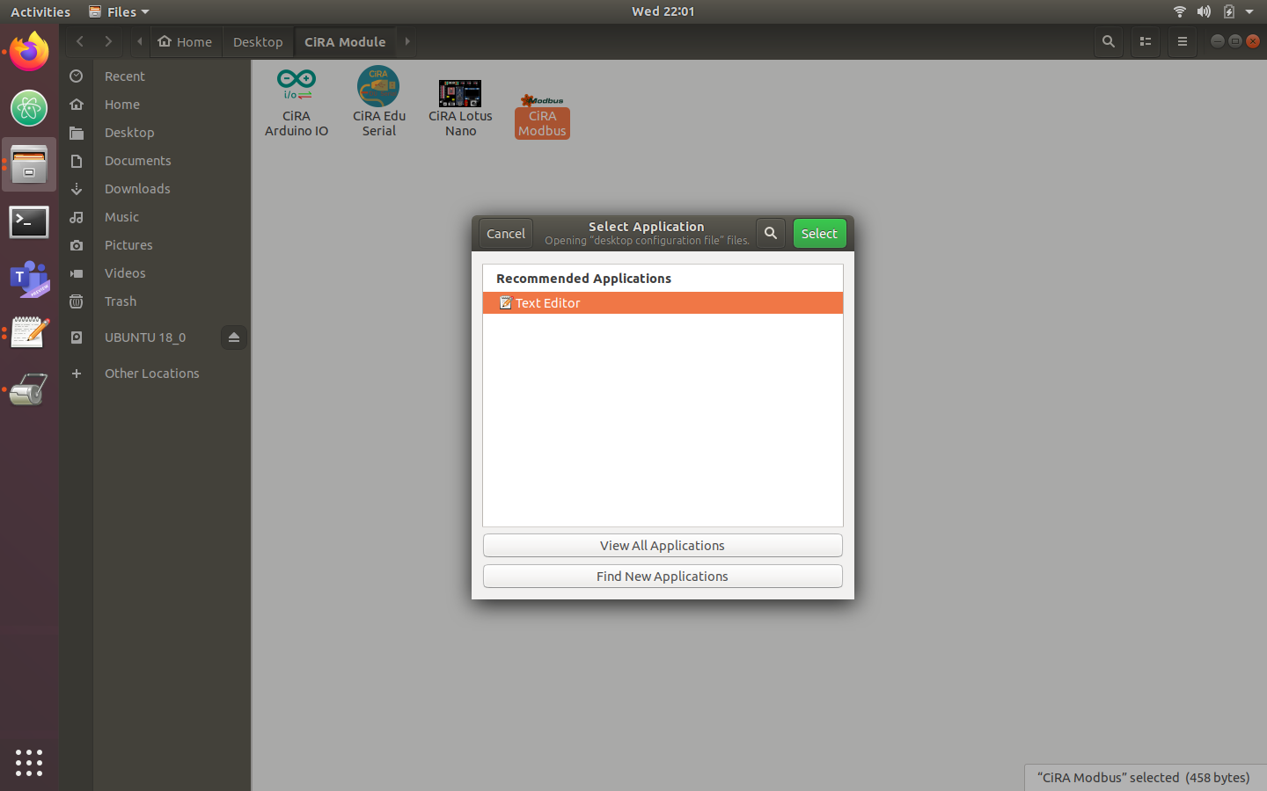
CiRA CORE Autorun (Some fix)
To autorun with ModBus
Open With Text Editor

Slide 4
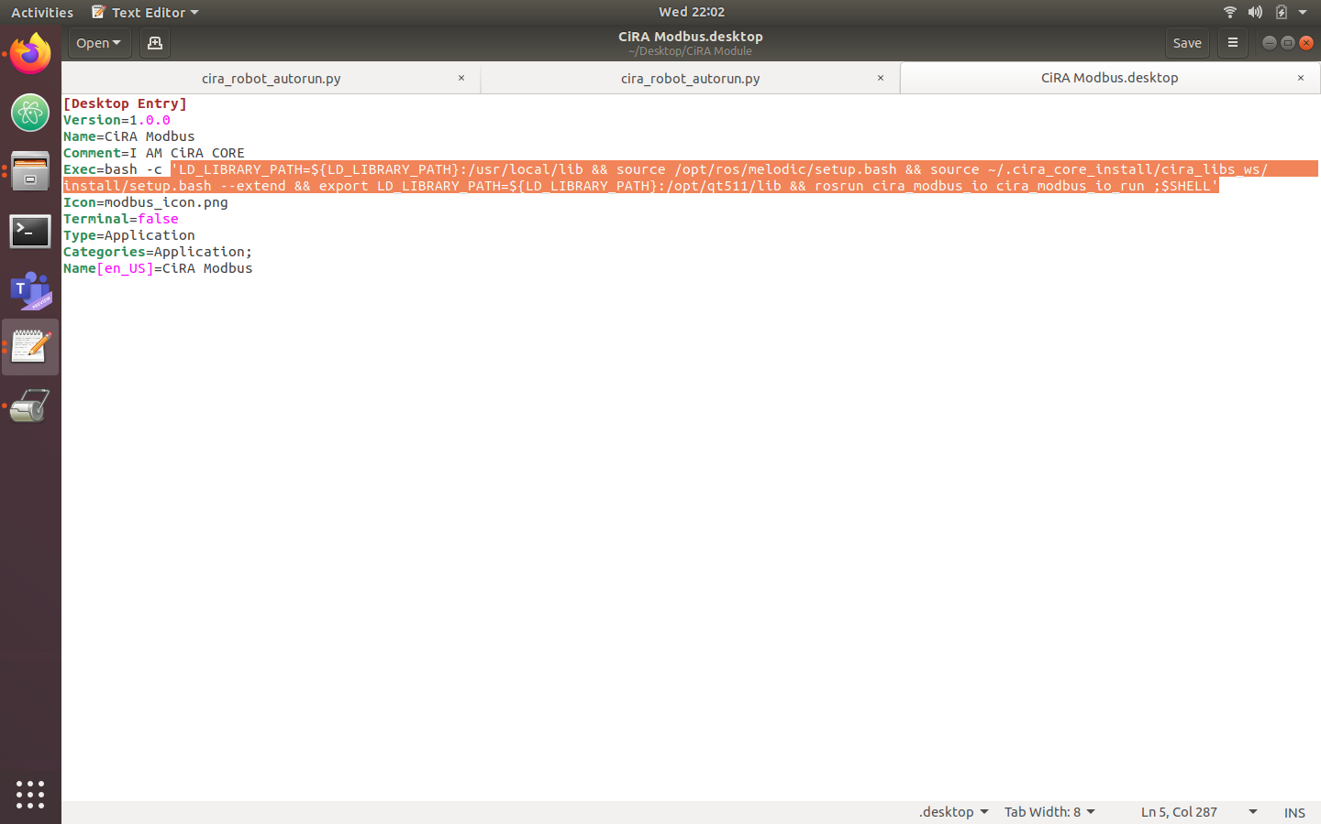
CiRA CORE Autorun (Some fix)
To autorun with ModBus
Copy this command

Slide 5
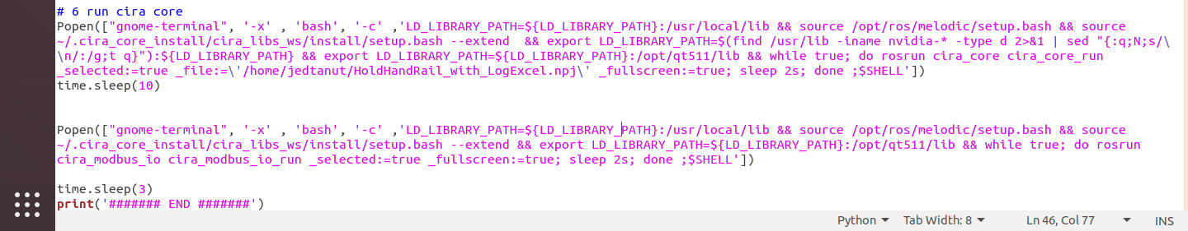
CiRA CORE Autorun (Some fix)
Copy this command
To autorun with ModBus
Paste the command
Paste the command
Add some time delay after cira core was run
Add all command below cira core run command

